Slide 1
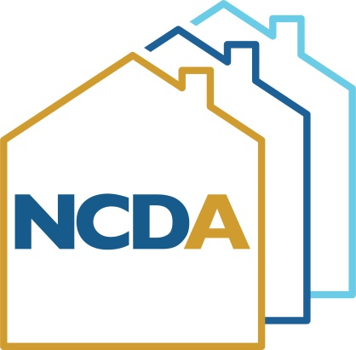
HOME Best Practices – Monitoring & Audit
Anne Marie Belrose – City of Boston, MA
NCDA Annual Conference
June 22-24, 2022

Slide 2
HUD Monitoring: Think of it as an open-book exam that you can ace.
Ask which activities will be monitored as soon as you receive a monitoring letter.
Ask which monitoring checklist will be used (your CPD representative will tell you.)
Get the checklist from hudexchange.info
Organize the file in a manner consistent with the checklist: label and tag every document that is responsive to a question on the checklist. Remove duplicative, incomplete, or draft documents that will make the files appear disorganized.
Complete the monitoring checklist yourself in preparation for the visit. There will be no surprises and will ensure the monitoring goes smoothly.

Slide 3
The Best Thing I Learned in 2022
You don’t need to review TIC, income, asset, and lease documents for every unit in your HOME portfolio every six years. You can do a sample instead!!!
Starting this year, we are (with HUD approval) reviewing documents for a sample of HOME units:
For projects with 5 or fewer HOME units, review documents for all HOME units.
For projects with greater than 5 HOME units, review documents for 5 units, or 20% of HOME units, whichever is greater.
This saves a HUGE amount of time and reduces audit and monitoring risk.

Slide 4
Avoid automatic recapture of HOME funds!!!
Make sure your written agreement is dated BEFORE your HOME commitment (funding date) in IDIS.
Our funding agreements are executed on the same date as the loan agreement and affordable housing restriction, which is the date they are recorded at the registry. We do not fund projects in IDIS until the closing is complete and all documents are signed.
Make sure that your written agreements contain all required elements – they are found easily on the monitoring checklist.

Slide 5
HOME written agreements – Key Provisions
Use of HOME funds (detail amount and purpose)
Address
Tasks to be performed by parties
Schedule for Completion, with Milestones
Project Budget (sources/uses)
Other Requirements: Extent of Agreement; Assignability; Indemnity; Bonding and Insurance; Compliance with Federal, State, and Local Laws; Breach and remedies.

Slide 6
HOME written agreements – Key Provisions
Key HOME requirements:
Eligible Occupants
Eligible Activities
Property Standards
Production Costs
Process for Disbursement of Funds
Tenant Selection

Slide 7
HOME written agreements – Key Provisions
Key HOME requirements, continued:
Subsidy Limits
Rent Restrictions and Allowance
Deed Restrictions
Lease requirements (ensure no disallowed provisions exist in leases)
Violence Against Women Act (VAWA)
Fees (must be reasonable and identified for amenities such as laundry, parking, etc.)
Broadband Installation
Duration of Agreement
Unit Characteristics
Utility Allowances

Slide 8
HOME written agreements – Key Provisions
Key HOME requirements, continued:
Monitoring
Record Keeping
Close-out Procedures
Davis-Bacon Applicability
Debarment and Suspension
Conflict of Interest
Other Federal Requirements (nondescrimination, EEO, disclosure requirements, drug-free workplace

Slide 9
Property Standards
Complete HQS inspections at least every years for every HOME project, regardless of size.
Frequency:
1-4 HOME-assisted units – all HOME-assisted units must be inspected
5 or more HOME-assisted units – 20% of HOME-assisted units, or one HOME-assisted unit per building, whichever is greater, must be inspected.

Slide 10
Property Standards
For newly constructed or rehabilitated properties, there must be at least one property inspection completed within a year of certificate of occupancy.

Slide 11
Property Standards – Corrective Actions
If there is a health/safety risk identified in the inspection report, it must be corrected within 24 hours of notification, and must be reinspected within 48 hours. Your written policy must identify what conditions constitute a health or safety risk:
Air Quality - Propane/Natural Gas/Methane Gas Detected
Blocked Egress/Ladders
Electrical Hazards - Exposed Wires/Open Panels
Electrical Hazards - Water Leaks on/near Electrical Equipment
Emergency Fire Exits - Emergency/Fire Exits Blocked/Unusable
Missing Outlet Covers
Missing/Damaged/Expired Extinguishers
Misaligned Chimney/Ventilation System
Outlets/Switches/Cover Plates - Missing/Broken
Smoke Detector - Missing/Inoperable
Windows - Security Bars Prevent Egress

Slide 12
PSA: Life can be beautiful, even if you have to monitor the HOME Program!

Slide 13
Questions?
I’m happy to share our HOME written agreement, rent certification template, and policies and procedure that HUD approved last year.
annemarie.belrose@boston.gov

